Slide 1



Slide 2
OC Curve?
Shape of OC curve
Types of OC curve
Specific Points On OC Curve
Probability Distributions used in OC Curve
OC Curve Uses
OC Curve Properties

Slide 3

OC Curve was Developed along with SQC in 1930’s and 40’s.
Graph used in quality control to determine the probability of accepting production lots.
Used in Discrimination of Sampling Plan Between Good
And Bad Lots.
Measures Performance of Acceptance Sampling Plans.

Slide 4

o Ideal OC Curve:
When percentage of Non-Conforming items are Below prescribed level Pa is 100%. And more than it makes Pa 0%.
Ideal OC Curve Can be Obtained By 100% Inspection.
Dividing line of Probability of acceptance Between 0 to 100% is AQL

Slide 5
Typical OC Curve:
This is Curve Roughly “S” Shaped.
Obtained by joining points between Probability of
acceptance & Percentage non conforming items.
Obtained by Performing Sampling Inspection.

Slide 6

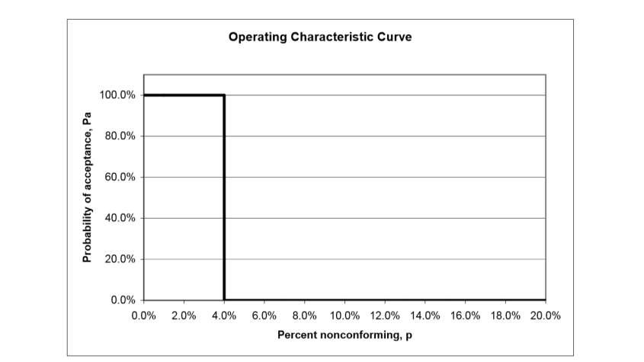

Slide 7

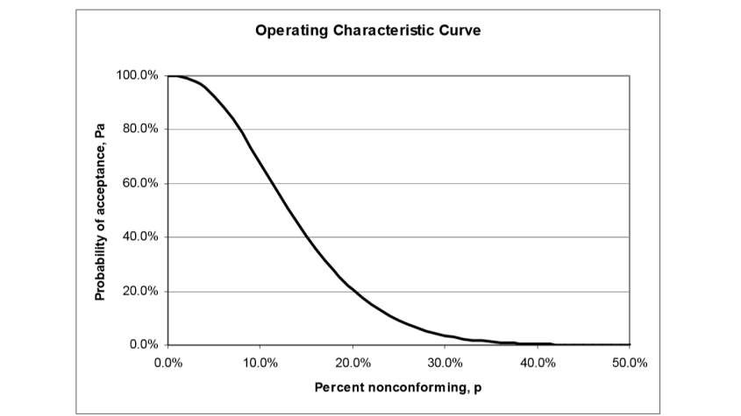

Slide 8
Type A
Gives the probability of acceptance for an individual lot coming from finite production
This Curves are discontinuous.
Type B
Give the probability of acceptance for lots coming from a continuous process
This Curves are correctly viewed as Continuous.

Slide 9

Assumes a finite lot.
Hypergeometric distribution is used for this type of curve.
Binomial or Poisson distribution often provides a
good approximation.
View point of Type A curve is to evaluate consumer’s risk
9

Slide 10

Assumes an infinite lot.
Binomial distribution is the correct one.
Poisson distribution often provides a good
approximation.
View Point Type B OC curve is to evaluate
producers risks.

Slide 11
Producer’s Risks (α):
Probability of Rejection of a conforming lot.
To Reduce Producers Risk Produce Product at a better
Quality Level Than AQL.
Value of Producer’s Risks is Commonly 5%.

Slide 12
Consumer’s Risks (β):
Risk associated with Consumer.
Probability of accepting a non-conforming lot.
Usually it is 10%.

Slide 13
AQL(Acceptable Quality Level):
Maximum Percent of defectives that will make lot easily acceptable.
Fraction of Defectives accepted without any serious effect on quality and customer relations.
PA for an AQL lot should be high.
AQL is also Termed as Producer’s “safe point”.

Slide 14
Rejectable Quality Level(RQL):
Quality Level Unacceptable to the Customer.
Definition Of Unsatisfactory Quality.
Characterised by low probability of acceptance.
PA of lot at RQL represents Consumer’s Risk.

Slide 15
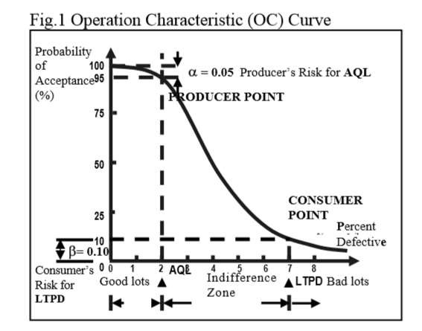

Slide 16
Y axis
Gives the probability that the lot will be accepted (Pa).
X axis = p
Percentage Defective.
Shows percentage-defectives along the horizontal ('X'), axis and probability of acceptance along the vertical ('Y') axis.

Slide 17
P_{A} = The probability of acceptance p = Proportion defective
N = Lot size
n = Sample size
c= Acceptance Number α = Producer’s Risk
β= Consumer’s Risk

Slide 18
Hyper geometric Distributions
Binomial Distributions
Poisson’s Distributions

Slide 19

The probability of exactly x defective parts in a sample n:
The hyper geometric distribution is used to calculate the probability of acceptance of a sampling plan when the lot is relatively small.
Calculations Becomes Cumbersome for large lot sizes.

Slide 20
o The binomial assumes that the probabilities associated with all samples are equal.
The probability of exactly x defective parts in a sample n:
o This is referred to as sampling with replacement.

Slide 21

Poisson Distributions
Used for sampling plans involving the number of defects or defects per unit rather than the number of defective parts.
When n is large and p is small, the Poisson distribution formula may be used.
o The probability of exactly x defects or defective parts in a sample n:
o The letter e represents the value of the base of the natural
logarithm system. It is a constant value (e = 2.71828).

Slide 22
Selection of sampling plans
Aids in selection of plans that are effective in reducing risk
keeps the high cost of inspection down

Slide 23


o Ideal curve would be perfectly perpendicular from 0 to 100% for a given fraction defective.

Slide 24


o Sampling Plans with Same Percent samples give very different quality protection.

Slide 25


Larger the sample size steeper is the slope of OC curve.
Larger sample size gives protection to consumer and producer.

Slide 26


